Slide 1
N5 Computing Science
Notes:
Python functions: https://docs.python.org/3/library/functions.html

Slide 2
Plan – N5 Year 1
SDD
Software Design and Development (40%)
DDD
Database Design and Development (25%)
WDD
Web Design and Development (25%)
Computer Systems (10%)
C/Sys
Notes:
Hide as appropriate

Slide 3
Implementation
Python

Slide 4
Learning Intentions
Describe and use internal commentary

Slide 5
Internal Commentary
Use internal commentary in all programs
As a minimum:
1 # Title: My First Program
2 # Name: Mr Friend
3 # Date: 15 January 2025
Ignored by computer
Hash symbol (comment)
Line numbers
Notes:
Helps to tell the 'story' of what the program does

Slide 6
Internal Commentary
Start all programs with internal commentary
As a minimum:
1 # Title:
2 # Name:
3 # Date:

Slide 7
Special Comments
Codetag
59 # TODO: Display result
74 # BUG: Not calculating correctly
Something to be done
Codetag
A problem to be sorted
Reminders of what needs to be done
Notes:
Excellence creep!
PEP 350 - https://peps.python.org/pep-0350/

Slide 8
Special Comments
59 # TODO: Display result
74 # BUG: Not calculating correctly

Slide 9
Learning Intentions
Describe and use output to screen

Slide 10
Display information
1 # Display words
2 print("Hello world")
3
4 # Display a number
5 print(3.14)
Text displayed
Number displayed

Slide 11
Display information
1 # Display words
2 print("Hello world")
3
4 # Display a number
5 print(3.14)
Notes:
After this, internal commentary omitted from slides to save space

Slide 12
Learning Intentions
Describe and identify syntax errors

Slide 13
Syntax Errors
Program will not run until all syntax errors corrected
1 # Display words
2 print(Hello world")
3
4 # Display a number
5 print(3.14
Opening quotation mark missing
Closing bracket missing
Notes:
Often, the line number of the error is where it is spotted not where it is.

Slide 14
Syntax Errors
1 # Display words
2 print(Hello world")
3
4 # Display a number
5 print(3.14

Slide 15
Learning Intentions
Describe and use data types

Slide 16
Data type – Character
A single character
A letter – "a", "z", "G"
A number – "0", "7"
A symbol – "!", ";", "@"
All with quotation marks
Notes:
Python also allows single quotation marks: 'abcXYZ'

Slide 17
Data type – Character
A letter – "a", "z", "G"
A number – "0", "7"
A symbol – "!", ";", "@"

Slide 18
Data type – String
A string of characters
Letters – "abcXYZ"
Numbers – "123890"
Symbols – "!£$*()"
Mixture – "Hello 2 u !!!!"
All with quotation marks
Notes:
Python also allows single quotation marks: 'abcXYZ'

Slide 19
Data type – String
Letters – "abcXYZ"
Numbers – "123890"
Symbols – "!£$*()"
Mixture – "Hello 2 u !!!!"

Slide 20
Data type – Integer
Whole numbers
Positive and negative
–9999
0
3

Slide 21
Data type – Integer
–9999
0
3

Slide 22
Data type – Real
Decimal numbers
Positive and negative
–99·999
0·0
3·14
Also known as ‘Floating point’

Slide 23
Data type – Real
–99·999
0·0
3·14

Slide 24
Data type – Boolean
Binary choice
True or False
Can be used to represent:
Yes / No
On / Off
1 / 0

Slide 25
Data type – Boolean
Can be used to represent:

Slide 26
Data types
Type | Description | Examples
Character | A single character | "a", "1", "@"
String | A string of characters | "Hello", "01871"
Integer | Whole numbers | 3, -99, 0
Real | Decimal numbers | 3·14, -99·6, 0·0
Boolean | Binary – two states | True / False

Slide 27
Data types
Type | Description | Examples
 |  | "a", "1", "@"
 |  | "Hello", "01871"
 |  | 3, -99, 0
 |  | 3·14, -99·6, 0·0
 |  | True / False

Slide 28
Learning Intentions
Assign values in a program

Slide 29

What is a variable?
Somewhere to store information
Has a name
Can be thought of as a box
Can only store 1 piece of info

Slide 30

How do they work?
Store 11 in variable1
Copy variable1 to variable2
Variable created, with a name
Value stored in it
11
11
variable1
variable2

Slide 31
What is it?
=
Maths: equals sign
(is the same as)
Computing: assignment operator
(is assigned the value )

Slide 32
What is it?
=
Maths:
Computing:

Slide 33
Assignment – variable
Value assigned
to variable
Variable name
Value to be stored
age = 18
Assignment operator
Notes:
A single value.

Slide 34
Assignment – variable
age = 18

Slide 35
String or Variable?
name
"name"
"date"
date
length
"length"
weight
"weight"
height
"height"
Strings have quotation marks
Notes:
Class: Markup strings with ink

Slide 36
String or Variable?
name
"name"
"date"
date
length
"length"
weight
"weight"
height
"height"

Slide 37
String or Number?
"999"
999
3.14
"3.14"
-0.03
"-0.03"
17.5
"17.5"
"42"
42
Strings have quotation marks
Notes:
Class: Markup strings with ink

Slide 38
String or Number?
"999"
999
3.14
"3.14"
-0.03
"-0.03"
17.5
"17.5"
"42"
42

Slide 39
Trace table
word1 | word2
1 word1 = "Hello"
2 word2 = "world"
3 word1 = "What?"
4 word1 = "Bye"
5 word2 = "all!"
"Hello"
"world"
"What?"
"Bye"
"all!"
Notes:
Not part of N5 but useful for clearing up misconceptions about variables
When a variable is overwritten there is no history of the previous value – obliterated!

Slide 40
Trace Table
word1 | word2
1 word1 = "Hello"
2 word2 = "world"
3 word1 = "What?"
4 word1 = "Bye"
5 word2 = "all!"

Slide 41
Display Variables
1 text = "Hello world"
2 print(text)
3
4 age = 17
5 print(age)
Variable name
Variable name

Slide 42
Display Variables
1 text = "Hello world"
2 print(text)
3
4 age = 17
5 print(age)

Slide 43
Learning Intentions
Describe and use meaningful identifiers

Slide 44
Variable names – Rules
Start with a letter
Only contain letters, numbers, underscores
No spaces
Unique
Examples
height cost
age number_2 number1

Slide 45
Variable names – Rules
Examples

Slide 46
Variable names – Conventions
Camel case
Meaningful
Singular (not plural)
Examples
pupilAge costPerKilo
petName examGrade
Notes:
Camel case – lower case with humps
Use singular for variable names
Uppercase letters used for constants: PI = 3·14

Slide 47
Variable names – Conventions
Examples

Slide 48
Learning Intentions
Describe and use arithmetic operations

Slide 49
Arithmetic Operators
Problem
Result
+ Add
– Subtract
* Multiply
/ Divide
** Power of
3 + 7 = 10
9 – 4 = 5
2 * 3 = 6
8 / 4 = 2.0
3 ** 2 = 9
Notes:
Python division always results in a real value
Task. Create variables & display result: add = 3 + 7 print(add) powerOf = 3**2 print(powerOf)

Slide 50
Arithmetic Operators
Problem
Result
Add
Subtract
Multiply
Divide
Power of
3 =
9 =
2 =
8 =
3 =

Slide 51
Learning Intentions
Describe and identify execution errors

Slide 52
Execution Errors
Program will run but then stop (crash)
1 print("All Good!")
2
3 age = 17
4 print(age / 0)
5
6 number = "2"
7 print(number + 2)
Division by zero
Incompatible data types

Slide 53
Execution Errors
1 print("All Good!")
2
3 age = 17
4 print(age / 0)
5
6 number = "2"
7 print(number + 2)

Slide 54
Learning Intentions
Describe and use the predefined function: round

Slide 55
Functions – Overview
Function
(Process)
Input
Output
Wash
Dirty clothes
Clean clothes
Capitalise
"hello"
"Hello"
Add together
7, 2
9

Slide 56
Functions – Overview

Slide 57
Round (Overview)
Function
Input
Output
Round (dp)
3·1415, 3
3·142
round()
3·1415, 2
3·14
round()
3·1415
3
Input: Real, Integer (optional)
Output: Real / Integer

Slide 58
Round (Overview)
Function
Input
Output
3·1415, 3
3·1415, 2
3·1415
Input:
Output:

Slide 59
round() – Example
Output
myValue =
round(3·1415, 2)
Function
Input
Decimal places can be omitted: round(6·23) → 6
Input to the function can be variables
Notes:
Decimal places can be omitted: round(6·23) → 6

Slide 60
round() – Example
myValue =
round(3·1415, 2)
Decimal places can be omitted: round(6·23) →
Input to the function can be
Notes:
Decimal places can be omitted: round(6·23) → 6
Python rounds 0·5 to the nearest even number: round(6·5) → 6

Slide 61
Rounding to an Integer
Integer
Integer
x ·1 ·2 ·3 ·4 ·5 ·6 ·7 ·8 ·9 x+1
?
round(3.5)
round(4.5)
Tied: rounds to nearest even integer
Notes:
Specific to Python

Slide 62
Rounding to an Integer
x ·1 ·2 ·3 ·4 ·5 ·6 ·7 ·8 ·9 x+1

Slide 63
Learning Intentions
Describe and use string concatenation

Slide 64
Joining words together
Hello
world
Notes:
Humans join words together to make meaning / sense

Slide 65
Joining strings together - concatenation
"Hello"
+
"world"
Notes:
Using a computer, strings can be joined together to make meaning / sense
“Glues” together

Slide 66
Concatenation Example
word1 | word2
"Hello"
1 word1 = "Hello"
2 word2 = "world"
3
4 text = word1 + word2
5 text = word1 + " " + word2
6 print(text)
"world"
text
"Helloworld"
"Hello world"
Notes:
https://whiteboard.fi/
Could add a space at the end of "Hello " or at the beginning of " world".

Slide 67
Concatenation Example
word1 | word2
1 word1 = "Hello"
2 word2 = "world"
3 text = word1 + word2
4 text = word1 + " " + word2
5 print(text)
text

Slide 68
Concatenation
Joins
strings
together
Not integers, real, or Boolean values
Notes:
What about other data types?

Slide 69
Concatenation

Slide 70
Learning Intentions
Describe and use the predefined function: length

Slide 71
Length – String (Overview)
Function
Input
Output
Count
Characters
"Hello"
5
len()
"C@t"
3
len()
"17"
2
Input: String
Output: Integer

Slide 72
Length – String (Overview)
Function
Input
Output
Input:
Output:

Slide 73
len() – String – Example
Output
myValue =
len("Hello")
Function
Input
Counts the characters
Input to the function can be a variable

Slide 74
len() – String – Example
myValue =
len("Hello")
Counts the
Input to the function can be a

Slide 75
Cast (convert) to String
Function
Input
Output
Cast to string
42
"42"
str()
3.14
"3.14"
str()
-0.059
"-0.059"
Input: Non-string
Output: String

Slide 76
Cast (convert) to String
Function
Input
Output
Input:
Output:

Slide 77
str() - Example
Output
myString =
str(42)
Function
Input
Casts non-string to string
Input can be a variable

Slide 78
str() - Example
myString =
str(42)

Slide 79
Python Example
word1 | num1
"Height:"
1 word1 = "Height:"
2 num1 = 1.56
3 text = word1 +
4 print(text)
1.56
text
" " +
str(num1)
"Height: 1.56"
Notes:
Could add a space at the end of "Hello " or at the beginning of " world", but poor

Slide 80
Python Example
word1 | num1
"Height:"
1 word1 = "Height:"
2 num1 = 1.56
3
4 text = word1 +
5 print(text)
"1.56"
text
"Height: 1.56"

Slide 81
Learning Intentions
Describe and use:
Python shell
print
input
Notes:
Indentation covered later

Slide 82
Learning Intentions
Describe and use:
meaningful identifiers
internal commentary
whitespace
indentation
Notes:
Indentation covered later

Slide 83
Readability
1 cow = 5
2 sea = 3
3 bob = sea + cow
4 print("Sum: " + str(bob))
1 value1 = 5
2 value2 = 3
3 total = value1 + value2
4 print("Sum: " + str(total))
1. Meaningful identifiers
Notes:
Code is to store two values, add them together, and display the result

Slide 84
Readability
1 cow = 5
2 sea = 3
3 bob = sea + cow
4 print("Sum: " + str(bob))
1 # Store two values
2 value1 = 5
3 value2 = 3
4 # Calculate the total
5 total = value1 + value2
6 # Display the result
7 print(Sum: " + str(total))
1. Meaningful identifiers
2. Internal commentary

Slide 85
Readability
1 cow = 5
2 sea = 3
3 bob = sea + cow
4 print("Sum: " + str(bob))
1 # Store two values
2 value1 = 5
3 value2 = 3
4
5 # Calculate the sum
6 total = value1 + value2
7
8 # Display the result
9 print("Sum: " + str(total))
1. Meaningful identifiers
2. Internal commentary
3. Whitespace
4. Indentation (not shown)
Notes:
Initial: Very poor Final: Much better
Python forces indentation to be used – no example shown

Slide 86
Readability
1 cow = 5
2 sea = 3
3 bob = sea + cow
4 print("Sum: " + str(bob))
1 # Store two values
2 value1 = 5
3 value2 = 3
4
5 # Calculate the sum
6 total = value1 + value2
7
8 # Display the result
9 print("Sum: " + str(total))
Notes:
Initial: Very poor Final: Much better
Python forces indentation to be used – no example shown

Slide 87
Learning Intentions
Describe and use keyboard input
Describe and use casting
Notes:
Not part of N5 specification but need: input( ), int( ), float( ), str( )
Could use eval( ) for numbers but don't

Slide 88
User input
Function
Input
Output
Get user input
"Enter name"
"Tom"
"Enter pi"
input()
"3.14"
input()
"Enter age"
"17"
Input: String (optional)
Output: String

Slide 89
User input
Function
Input
Output
Input:
Output:

Slide 90
input() – Example
input( ) function
Output
name = input("What is your name? ")
Displayed on the screen (optional)
Everything from the keyboard is a string!
Notes:
Computer waits for user input from the keyboard. Whatever is entered is a string, no matter what it looks like, i.e. if the user enters 42 it is not a number but a string.

Slide 91
input() – Example
name = input("What is your name? ")

Slide 92
Python Example
value1 | value2
1 value1 = input("1st: ")
2 value2 = input("2nd: ")
3 result = value1 + value2
4 print(result)
result
Everything from the keyboard is a string!
Notes:
https://whiteboard.fi/
1. Run through with strings : "Big" + "dog" = "Bigdog"
2. Run through with ‘integers’: "4" + "2" = "42"

Slide 93
Python Example
value1 | value2
1 value1 = input("1st: ")
2 value2 = input("2nd: ")
3 result = value1 +
4 print(result)
result

Slide 94
Cast (convert) to Integer
Function
Input
Output
Cast to integer
"42"
42
int()
"0"
0
int()
"-9"
-9
Input: String
Output: Integer

Slide 95
Cast (convert) to Integer
Function
Input
Output
Input:
Output:

Slide 96
int() - Example
Output
myInteger =
int("42")
Function
Input
Converts string to integer
Input can be a variable

Slide 97
int() - Example
myInteger =
int("42")

Slide 98
Cast (convert) to Real
Function
Input
Output
Cast to real
"4.2"
4.2
float()
"0"
0.0
float()
"-9.6"
-9.6
Input: String
Output: Real

Slide 99
Cast (convert) to Real
Function
Input
Output
Input:
Output:

Slide 100
float() - Example
Output
myReal =
float("4.2")
Function
Input
Converts string to real
Input can be a variable

Slide 101
float() - Example
myReal =
float("4.2")

Slide 102
Using Multiple Functions
Function 1
Function 2
Input
Output / Input
Output
input()
"17"
int()
"Age?"
17
input()
"3.14"
float()
"Pi?"
3.14
Output of one function = input of the next function

Slide 103
Using Multiple Functions
Function 1
Function 2
Input
Output / Input
Output

Slide 104
input() & int() - Example
Output 1 /
Input 2
Output 2
age =
int( )
input("Age? ")
Function 2
Input 1
Function 1

Slide 105
input() & int() - Example
age =
int( )
input("Age? ")

Slide 106
Python Example
value1 | value2
1 value1 = int(input("1st: "))
2 value2 = int(input("2nd: "))
3 result = value1 + value2
4 print(result)
result
Notes:
Run through with integers: 4 + 2 = 6

Slide 107
Python Example
value1 | value2
1 value1 = (input("1st: "))
2 value2 = int(input("2nd: "))
3 result = value1 +
4 print(result)
result

Slide 108
Learning Intentions
Describe and use normal test data in a test table
Describe and identify syntax, execution, and logic errors

Slide 109
Error Types
Syntax – program won't run / compile
Execution – program stops running
Logic – executes but wrong result – hardest to find
Notes:
Syntax: Print("Hello)
Execution: 2 + "2"

Slide 110
Error Types
Syntax –
Execution –
Logic –

Slide 111
Normal Test Data
Normal – values that are expected
Test Data – selected before testing
Expected output – what should be produced
Actual output – what is produced
Normal
Simulate a die: -2, -1, 0, 1, 2, 3, 4, 5, 6, 7, 8 , 9
Notes:
Normal: 1-6

Slide 112
Normal Test Data
Normal –
Test Data –
Expected output –
Actual output –
Simulate a die: -2, -1, 0, 1, 2, 3, 4, 5, 6, 7, 8 , 9

Slide 113
Test table – Normal
Problem: add two values
Test data | Test type | Expected | Actual | Comment
2, 2 | Normal | 4 | 4 | Pass
2, 3 | Normal | 5 | 6 | Fail
2, 10 | Normal | 12 | 20 | Fail
Do this before writing code
Do this when running tests
Iterate until it passes all the tests!
Notes:
Test table layout is not fixed- amend as necessary
https://n5-sdd-normal-testing.esafriend1r.repl.co/

Slide 114
Test table – Normal
Problem: add two values
Test data | Test type | Expected | Actual | Comment
 | Normal
 | Normal
 | Normal

Slide 115
Test table – Normal - Practise
Problem:
Test data | Test type | Expected | Actual | Comment

Slide 116
Learning Intentions
Describe and use fixed loops

Slide 117
Sequences
Start value
(inclusive)
range(1, 5)
1, 2, 3, 4
range( ) function
Stop value
(exclusive)
range(5)
0, 1, 2, 3, 4
All values
integers
Stop value (starts at 0)
range(1, 5, 2)
1, 3
Step value
Notes:
If a start value isn’t specified, then it’s 0 (zero).
Info only: list(range(1, 10)) → [1, 2, 3, 4, 5, 6, 7, 8, 9]

Slide 118
Sequences
Start value
range(1, 5)
1, 2, 3, 4
range( ) function
Stop value
range(5)
0, 1, 2, 3, 4
All values
integers
Stop value (starts at 0)
range(1, 5, 2)
1, 3
Step value
Notes:
If a start value isn’t specified, then it’s 0 (zero).
Info only: list(range(1, 10)) → [1, 2, 3, 4, 5, 6, 7, 8, 9]

Slide 119
Sequences
range(1, 5)
1, 2, 3, 4
range(5)
0, 1, 2, 3, 4
range(1, 5, 2)
1, 3

Slide 120
Fixed Loop – Example 1
Colon
Loop variable
1 for counter in range(1, 5):
2 print(counter)
3
4 for number in range(5):
5 print(number)
Code to be repeated indented
Loop variable
Notes:
Keywords: for, in
Function: range( )
If a start value isn’t specified, then it’s 0 (zero).

Slide 121
Fixed Loop – Example 1
1 for counter in range(1, 5):
2 print(counter)
3
4 for number in range(5):
5 print(number)

Slide 122
Fixed Loop – Example 2
Step
1 for value in range(1, 10, 2):
2 print(value)
Start and Stop values required if Step used

Slide 123
Fixed Loop – Example 2
1 for value in range(1, 10, 2):
2 print(value)

Slide 124
Learning Intentions
Describe and use:
meaningful identifiers
internal commentary
whitespace
indentation

Slide 125
Indentation
spaces at the start of a line
indicates a block of code
Python: very important
Python: follows a colon
1 for counter in range(1, 6):
2
3 # Count
4 print(counter)
5
6 # Squared
7 print(counter ** 2)
8
9 print("All done!")
Code block
Code block end
(Not indented)

Slide 126
Indentation
spaces at the
indicates a
Python:
Python: follows
1 for counter in range(1, 6):
2
3 # Count
4 print(counter)
5
6 # Squared
7 print(counter ** 2)
8
9 print("All done!")

Slide 127
Learning Intentions
Describe and use a standard algorithm for a running total within a loop

Slide 128
Running total (Fixed Loop)
1 value = 0
2 total = 0
3
4 for counter in range(4):
5
6 value = int(input("Value: "))
7
8 total = total + value
Initialise variables
How many values to add
Get new value
Add to total
Notes:
Use trace table

Slide 129
Running total (Fixed Loop)
1 value = 0
2 total = 0
3
4 for counter in range(4):
5
6 value = int(input("Value: "))
7
8 total = total + value
Notes:
Use trace table

Slide 130
Learning Intentions
Describe and use simple conditions

Slide 131
Boolean
True
1
On
Yes
False
0
Off
No

Slide 132
Boolean

Slide 133
Comparison Operators
/ Relational Operators
==
>
>=
<
<=
!=
Equality, the same
Greater than
Greater than or equal to
Less than
Less than or equal to
Inequality, not the same

Slide 134
Comparison Operators
==
>
>=
<
<=
!=

Slide 135
True or False?
5 == 5
5 < 3
6 != 9
89 >= 89
val1 = 7.5 val2 = 7.5
val1 == val2
"A" == "a"
True != False
True
False
True
True
True
False
True
Notes:
Use Thonny shell / console

Slide 136
True or False?
5 == 5
5 < 3
6 != 9
89 >= 89
val1 = 7.5 val2 = 7.5
val1 == val2
"A" == "a"
True != False

Slide 137
Learning Intentions
Describe and use selection with simple conditions

Slide 138
Decisions
If your eyes are blue, raise your hand
If your hair is dark, put a finger on your nose
If the test is True, do something
If the test is False, do nothing

Slide 139
if – Single Selection
Example 1
Example 2
1 2 3 4 5 6 7 | number = 5 if number > 0: # code # code # code after
1 2 3 4 5 6 7 | number = -5 if number > 0: # code # code # code after
True
False

Slide 140
if – Single Selection
1 2 3 4 5 6 7 | number = 5 if number > 0: # code # code # code after
1 2 3 4 5 6 7 | number = -5 if number > 0: # code # code # code after

Slide 141
if

Slide 142
Decisions
If your eyes are blue, raise your hand
Otherwise, put a finger on your nose
If your hair is dark, put a finger on your nose
Otherwise, raise your hand
If the test is True, do something
If the test is False, do something else

Slide 143
if, else – Double Selection
Example 1
Example 2
1 number = 5
2
3 if number == 5:
4 # True
5
6 else:
7 # False
1 number = -5
2
3 if number == 5: 4 # True
5
6 else:
7 # False
True
False

Slide 144
if, else – Double Selection
1 number = 5
2
3 if number == 5:
4 # True
5
6 else:
7 # False
1 number = -5
2
3 if number == 5: 4 # True
5
6 else:
7 # False

Slide 145
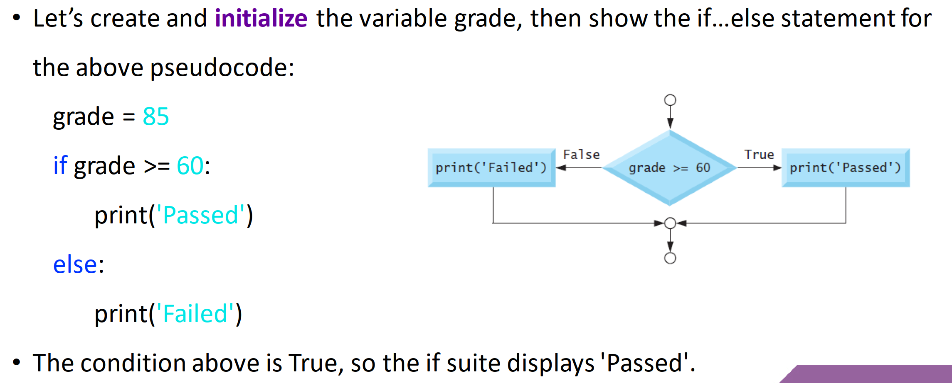
if, else

Slide 146
if, else if, else – Multiple Selection
1 number = -5
2
3 if number > 0:
4 print("Positive")
5 elif number < 0:
6 print("Negative")
7 else:
8 print("Zero")
Multiple elif allowed
else not mandatory
Tests done in order
Exits selection when a condition is True or else used

Slide 147
if, else if, else – Multiple Selection
1 number = -5
2
3 if number > 0:
4 print("Positive")
5 elif number < 0:
6 print("Negative")
7 else:
8 print("Zero")

Slide 148
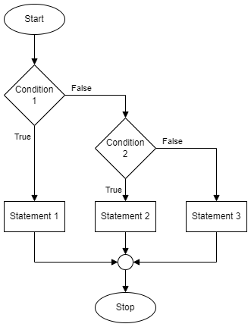
If
Else if
(multiple allowed)
Else
(not mandatory)

Slide 150
Learning Intentions
Describe and use extreme test data in a test table
Describe and identify execution and logic errors
Notes:
Extreme – at the limits / edge

Slide 151
Extreme Test Data
Extreme – at limit of selection – either side
1 number = int(input("Number: "))
2
3 if number < 0:
4 print("Negative")
Line 1 | Number:
Line 3 | Boolean:
-2 -1 0 1 2
Notes:
Add: T T F F F
Mark: extreme values

Slide 152
Extreme Test Data
Extreme – at limit of selection – either side
1 number = int(input("Number: "))
2
3 if number < 0:
4 print("Negative")
Line 1 | Number:
Line 3 | Boolean:

Slide 153
Test table – Extreme
Problem: Determine if an integer bigger than 10
Test data | Test type | Expected | Actual | Comment
5 | Normal | False | False | Pass
10 | Extreme | False | True | Fail
11 | Extreme | True | True | Pass
Do this before writing code
Do this when running tests
Iterate until it passes all the tests!

Slide 154
Test table – Extreme
Problem: integer bigger than 10?
Test data | Test type | Expected | Actual | Comment
 | Normal
 | Extreme
 | Extreme

Slide 155
Learning Intentions
Describe and use logical operators (AND, OR, NOT)

Slide 156
AND – Logical Operator
Condition 1 | Condition 2 | Overall
False | False | False
False | True | False
True | False | False
True | True | True
All conditions must be True!

Slide 157
AND – Logical Operator
Condition 1 | Condition 2 | Overall

Slide 158
AND – True or False?
False
5 < 2 AND 9 > 3
3 > 1 AND 8 > 4
8 > 7 AND 6 < 2
89 >= 98 AND 8 == 9
17 != 17 AND 17 == 17
"A" != "a" AND "B" > "A"
False
True
False
False
False
True
True
True
True
False
First condition False?
All others ignored!
False
False
True
True
Notes:
If first condition is False, all other conditions are ignored.

Slide 159
AND – True or False?
5 < 2 AND 9 > 3
3 > 1 AND 8 > 4
8 > 7 AND 6 < 2
89 >= 98 AND 8 == 9
17 != 17 AND 17 == 17
"A" != "a" AND "B" > "A"

Slide 160
OR – Logical Operator
Condition 1 | Condition 2 | Overall
False | False | False
False | True | True
True | False | True
True | True | True
One or more conditions must be True!

Slide 161
OR – Logical Operator
Condition 1 | Condition 2 | Overall

Slide 162
OR – True or False?
3 > 1 OR 8 > 4
7 > 8 OR 2 < 6
89 >= 98 OR 8 == 9
17 != 17 OR 17 == 17
"A" == "a" OR "B" > "A"
True
True
False
True
True
First condition True?
All others ignored!
Notes:
If first condition is True, all other conditions are ignored.

Slide 163
OR – True or False?
3 > 1 OR 8 > 4
7 > 8 OR 2 < 6
89 >= 98 OR 8 == 9
17 != 17 OR 17 == 17
"A" == "a" OR "B" > "A"

Slide 164
NOT – Logical Operator
Condition | Overall
False | True
True | False
Opposites!

Slide 165
NOT – Logical Operator
Condition | Overall

Slide 166
NOT – True or False?
NOT ( 5 < 2 )
NOT ( 3 > 1 AND 4 > 8 )
NOT ( 8 > 9 OR 6 <= 6 )
True
True
False

Slide 167
NOT – True or False?
NOT ( 5 < 2 )
NOT ( 3 > 1 AND 4 > 8 )
NOT ( 8 > 9 OR 6 <= 6 )

Slide 168
Learning Intentions
Describe and use extreme test data in a test table
Describe and identify execution and logic errors
Notes:
Extreme – at the limits / edge

Slide 169
Extreme Test Data
Extreme – normal test data but at limit of:
acceptable values
decisions (selection) – either side
Normal
Simulate a die: -2, -1, 0, 1, 2, 3, 4, 5, 6, 7, 8 , 9
Extreme

Slide 170
Extreme Test Data
Extreme – normal test data but at limit of:
acceptable values
decisions (selection) – either side
Simulate a die: -2, -1, 0, 1, 2, 3, 4, 5, 6, 7, 8 , 9

Slide 171
Learning Intentions
Describe and use selection with complex conditions
Notes:
No slides

Slide 172
Example 1 – Body Temperature
1 temp = float(input("Body temp (deg C): "))
2
3 if temp >= 36.1 and temp <= 37.2:
4 print("Normal body temperature")
5 else:
6 print("Not normal body temperature")
How many extreme values (1 dp) are needed?
Notes:
Source: https://medlineplus.gov/ency/article/001982.htm
Create test table then implement

Slide 173
Example 2 – Theme Park Ride
1 age = int(input("Age (years): "))
2 height = float(input("Height (metres): "))
3
4 if age >= 10 and height >= 1.2:
5 print("All criteria met")
Create test. Implement. Test.
Notes:
Theme park ride. Minimum age and minimum height restrictions.
Create test table then implement / Supersize with elif, else to shown failed criteria.

Slide 174
Task – Jockeys
Professional jockeys are small and light.
Determine if someone is a potential jockey.
They must have:
Maximum height of 1 metre, i.e. 1.00
Maximum weight of 15 kg, i.e. 15.0
Display some kind words if they're not suitable.
Design user interface. Create tests. Implement. Test.
Notes:
Completely made-up criteria!
Design interface, create test table, implement, test

Slide 175
Learning Intentions
Describe and use efficient selection

Slide 176
Efficient coding (1)
Inefficient
Efficient
Two
tests
One
test
Faster,
Simpler
1 if score >= 60:
2 print("Pass")
3
4 if score < 60:
5 print("Fail")
1 if score >= 60:
2 print("Pass")
3
4 else:
5 print("Fail")

Slide 177
Efficient coding (1)
1 if score >= 60:
2 print("Pass")
3
4 if score < 60:
5 print("Fail")
1 if score >= 60:
2 print("Pass")
3
4 else:
5 print("Fail")

Slide 178
Selection – if, else if, else (3 or more options)
Generic
Python
IF <condition 1> is true THEN
do something
ELSE IF <condition 2> is true THEN
do something else
ELSE
do this instead
END IF
if 5 < 2:
print("True")
elif 5 == 2:
print("Another option")
else:
print("All False")
Else can be omitted

Slide 179
Selection – if, else if, else (3 or more options)
Generic
Python
IF <condition 1> is true THEN
do something
ELSE
do this instead
END IF
if 5 < 2:
print("True")
else:
print("All False")

Slide 180
Efficient coding (2)
Else if (multiple allowed)
Inefficient
Efficient
1 if age >= 67:
2 print("Retired")
3
4 if age >= 18 and age < 67:
5 print("Working aged")
6
7 if age < 18:
8 print("School aged")
1 if age >= 67:
2 print(" Retired")
3
4 elif age >= 18:
5 print("Working aged")
6
7 else:
8 print("School aged")
3 or 4 conditions tested
1 or 2 conditions tested
Notes:
Inefficient: every condition is evaluated, every time
Efficient: at first True condition selection terminates
run through with 20

Slide 181
Efficient coding (2)
1 if age >= 67:
2 print("Retired")
3
4 if age >= 18 and age < 67:
5 print("Working aged")
6
7 if age < 18:
8 print("School aged")
1 if age >= 67:
2 print(" Retired")
3
4 elif age >= 18:
5 print("Working aged")
6
7 else:
8 print("School aged")

Slide 182
Task – SQA Grades
SQA exam results are graded:
A 70-100
B 60-69
C 50-59
D 40-49
No Award 0-39
Assumptions
All values integers
Values will be 0-100
Create a test table first!
Notes:
Create test table then implement

Slide 183
Learning Intentions
Describe and use conditional loops

Slide 184
Conditional Loop
WHILE condition is True DO
something
END WHILE
Code to be repeated
Code is only run if the condition is True
Notes:
Only enter the loop when the condition is True.
Only exit the loop when the condition is False.

Slide 185
Conditional Loop
condition is True DO
END

Slide 186
Conditional Loop
1 number = int(input("Number: "))
2
3
4 while number < 10:
5 number = number + 1
6 print(number)
Keyword
Condition
True
False
Code repeats while the condition is True
Notes:
what happens if <age> is 3, 5, 9 ?
Condition can be complex

Slide 187
Conditional Loop
1 number = int(input("Number: "))
2
3
4 while number < 10:
5 number = number + 1
6 print(number)

Slide 188
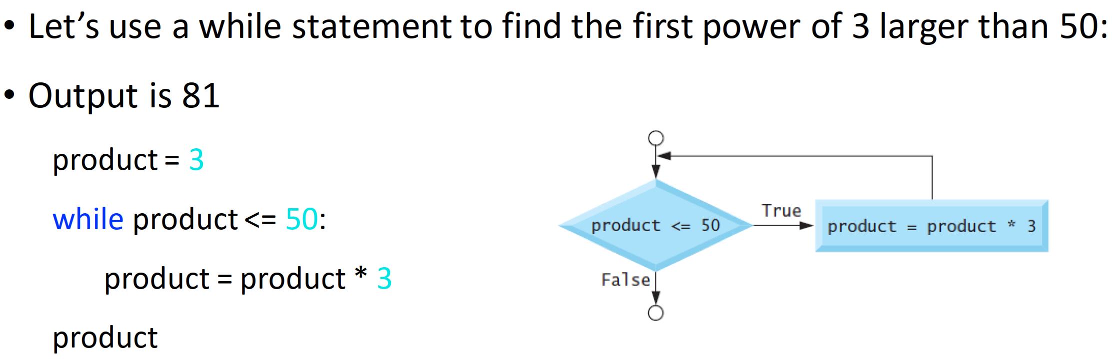
While

Slide 189
Learning Intentions
Describe and use a standard algorithm for input validation
Notes:
Used to limit input values to acceptable values

Slide 190
User input
1 pax = int(input("Passengers: "))
2
3 print("Taxi for " + str(pax))
Notes:
Simple condition

Slide 191
Input validation – Overview
1 Initialise variable used in condition
2 Repeat until condition is FALSE
3 Get input from user
4 Check user input
5 Display error message if needed

Slide 192
Input validation – Overview
1 Initialise variable used in
2 until condition is
3 Get from user
4 user
5 Display , if needed

Slide 193
Input validation – Input before loop
User input
1 pax = int(input("Passengers: "))
2
3 while pax < 1:
4
5 print("Must be at least 1.")
6
7 pax = int(input("Passengers: "))
Must be True to begin
Error message: meaningful
User input
Conditional loop might not be used
Notes:
Simple condition. Error message to be meaningful, i.e. better than "Invalid"
Number of taxi passengers

Slide 194
Input validation – Input before loop
1 pax = int(input("Passengers: "))
2
3 while pax < 1:
4
5 print("Must be at least 1.")
6
7 pax = int(input("Passengers: "))
8

Slide 195
Input validation – Input in loop
Not an acceptable value
Must be True to begin
1 pax = 0
2 while pax < 1:
3
4 pax = int(input("Passengers: "))
5
6 if pax < 1:
7 print("Must be at least 1.")
User input
Error message: meaningful
Conditional loop always used
Notes:
Simple condition. Error message to be meaningful, i.e. better than "Invalid"
Number of taxi passengers

Slide 196
Input validation – Input in loop
1 pax = 0
2 while pax < 1:
3
4 pax = int(input("Passengers: "))
5
6 if pax < 1:
7 print("Must be at least 1.")

Slide 197
Input validation – complex condition
Not an acceptable value
Must be True to begin
1 pax = 0
2 while pax < 1 or pax > 5:
3
4 pax = int(input("Passengers: "))
5
6 if pax < 1 or pax > 5:
7 print("Must be 1 to 5.")
User input
Error message
Notes:
Complex condition. Error message to be meaningful, i.e. better than "Invalid"

Slide 198
Input validation – complex condition
1 pax = 0
2 while pax < 1 or pax > 5:
3
4 pax = int(input("Passengers: "))
5
6 if pax < 1 or pax > 5:
7 print("Must be 1 to 5.")

Slide 199
Input validation – simple string
1 fact = ""
2 while fact != "Computing":
3
4 fact = input("Best subject? ")
5
6 if fact != "Computing":
7 print("Computing is the best!")

Slide 200
Task – Add Input Validation
Add input validation to the following Replit tasks:
N5 SDD Ask Questions – Loops: Min 1
N5 SDD School Days Left – Days: Min 0, Max 190
N5 SDD - Decisions Decisions – Voucher: "yes" or "no"
Notes:
Input validation
Efficient selection

Slide 201
Task – University Degree Classifications
Degrees are given classifications:
First 70-100
2-1 60-69
2-2 50-59
Third 40-49
Fail 0-39
Assumptions
All values integers
Create a test table first!
Notes:
Input validation
Efficient selection

Slide 202
Learning Intentions
Describe and use exceptional test data in a test table
Describe and identify syntax, execution, and logic errors
Notes:
Exceptional – beyond the limits / not acceptable

Slide 203
Exceptional Test Data
Exceptional – values that are not acceptable
Normal
Simulate a die: -2, -1, 0, 1, 2, 3, 4, 5, 6, 7, 8 , 9
Extreme
Exceptional
Exceptional

Slide 204
Exceptional Test Data
Exceptional – values that
Simulate a die: -2, -1, 0, 1, 2, 3, 4, 5, 6, 7, 8 , 9

Slide 205
Test table – Exceptional
Problem: Accept integers that are 1 or more
Test data | Test type | Expected | Actual | Comment
5 | Normal | Accept | Accept | Pass
1 | Extreme | Accept | Accept | Pass
0 | Exceptional | Reject | Accept | Fail
Do this before writing code
Do this when running tests
Iterate until it passes all the tests!
Notes:
Test table layout is not fixed - amend as necessary

Slide 206
Test table – Exceptional
Problem: Accept integers that are 1 or more
Test data | Test type | Expected | Actual | Comment
 | Normal
 | Extreme
 | Exceptional

Slide 207
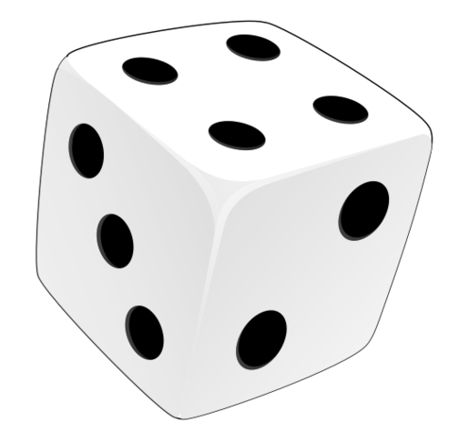
Conditional Loop – Testing
Enter the loop – exceptional test
Stay in the loop – exceptional test (if appropriate)
Exit the loop – extreme test
Test Data | Test Type | Expected | Actual | Comment
3 | Normal | Accepted
6 | Extreme | Accepted
0 | Exceptional | Error message |  | Enter
7 | Exceptional | Error message |  | Stay in
1 | Extreme | Accepted |  | Exit
Notes:
Value of a die

Slide 208
Conditional Loop – Testing
Test Data | Test Type | Expected | Actual | Comment
3 | Normal | Accepted
6 | Extreme | Accepted
0 | Exceptional | Error message |  | Enter
7 | Exceptional | Error message |  | Stay in
1 | Extreme | Accepted |  | Exit

Slide 209
Learning Intentions
Describe and use a standard algorithm for a running total within a loop

Slide 210
Running total (Fixed loop)
1 value = 0
2 total = 0
3
4 for counter in range(4):
5
6 value = int(input("Value? "))
7 total = total + value
Notes:
Revision

Slide 211
Running total (Conditional Loop)
Not an acceptable value
1 answer = ""
2 value, total = 0, 0
3
4 while answer != "no":
5 value = int(input("Value? "))
6 total = total + value
7
8 answer = input("Again? ")
Python shorthand (Don't use!)
Notes:
Loops until condition is false

Slide 212
Running total (Conditional Loop)
1 answer = ""
2 value, total = 0, 0
3
4 while answer != "no":
5 value = int(input("Value? "))
6 total = total + value
7
8 answer = input("Again? ")

Slide 213
Learning Intentions
Describe and use the 1-D array data structure
Notes:
Not a data type but a data structure

Slide 214
Variables – How many are needed?
A postcode
The ages of 5 pupils
Rainfall for every day of a year
postcode = "HS9 5XD"
age1 = 11
age2 = 14
age3 = 13
age4 = 14
age5 = 12
365 or 366 variables!
Multiple variables are inefficient

Slide 215
Multiple variables → An array
age1 = 11
age2 = 14
age3 = 13
age4 = 14
age5 = 12
[ , , , , ]
11
14
13
14
12
An array is a collection of values of the same datatype

Slide 216
Multiple variables → An array
age1 = 11
age2 = 14
age3 = 13
age4 = 14
age5 = 12
11
14
13
[ , , , , ]
14
12

Slide 217
Assignment – array
Array assigned
to variable
Array name
Values to be stored
ages = [11, 14, 13, 14, 12]
Assignment operator
Values are same data type. Plural used for array names.

Slide 218
Assignment – array
ages = [11, 14, 13, 14, 12]

Slide 219
Array elements / index
Elements
ages = [11, 14, 13, 14, 12]
Index value:
0
1
2
3
4
An array is a data structure

Slide 220
Array elements / index
ages = [11, 14, 13, 14, 12]

Slide 221
Python Example – Access Elements
0 1 2 3 4
1 ages = [11, 14, 15, 14, 13]
2 print(ages)
3
4 age = ages[1]
5 print(age)
6
7 old = ages[3] + 10
8 print(old)
Subscript operator
Index

Slide 222
Python Example – Access Elements
1 ages = [11, 14, 15, 14, 13]
2 print(ages)
3
4 age = ages[1]
5 print(age)
6
7 old = ages[3] + 10
8 print(old)

Slide 223
Python Example – Replace Elements
1 names = [""] * 4
2 print(names)
3
4 names[2] = "Tom"
5 names[0] = "Emma"
6
7 print(names)
Python shorthand
(Do use!)
Index

Slide 224
Python Example – Replace Elements
1 names = [""] * 4
2 print(names)
3
4 names[2] = "Tom"
5 names[0] = "Emma"
6
7 print(names)

Slide 225
Say What You See!
["Hip", "Hip"]

Slide 226
Learning Intentions
Describe and use the predefined function: length

Slide 227
Length – Array (Overview)
Function
Input
Output
Count
Elements
[1, 5, 9, 0]
4
len()
["In","At","Pi"]
3
len()
[True, False]
2
Input: Array
Output: Integer

Slide 228
Length – Array (Overview)
Function
Input
Output
[1, 5, 9, 0]
["In","At","Pi"]
[True, False]
Input:
Output:

Slide 229
len() – Array – Example
Output
myValue =
len([1, 5, 9])
Function
Input
Counts the elements
Input to the function can be a variable

Slide 230
len() – Array – Example
myValue =
len([1, 5, 9])
Counts the
Input to the function can be a

Slide 231
Learning Intentions
Describe and use a standard algorithm for traversing a 1-D array

Slide 232
Traversing an array – Data in
1 ages = [0] * 5
2
3 for index in range(5):
4 age = int(input("Age? "))
5 ages[index] = age
Loop for 5 values
Loop variable
Get value
Assign to array

Slide 233
Traversing an array – Data in
1 ages = [0] * 5
2
3 for index in range(5):
4 age = int(input("Age? "))
5 ages[index] = age

Slide 234
Traversing an array – Data out (1)
1 ages = [11, 14, 13, 14, 12]
2
3 for index in range(len(ages)):
4 print(ages[index])
Loops for each element in array – Displays one at a time

Slide 235
Traversing an array – Data out (1)
1 ages = [11, 14, 13, 14, 12]
2
3 for index in range(len(ages)):
4 print(ages[index])
Loops for each element in array –

Slide 236
Traversing an array – Data out (2)
1 ages = [11, 14, 13, 14, 12]
2
3 for age in ages:
4 print(age)
Loops for each element in array – Displays one at a time
Known as For Each

Slide 237
Traversing an array – Data out (2)
1 ages = [11, 14, 13, 14, 12]
2
3 for age in ages:
4 print(age)
Loops for each element in array –

Slide 238
Learning Intentions
Describe and use array concatenation

Slide 239
Concatenate – Strings – Revision
1 text = ""
2
3 for counter in range(5):
4 text = text + str(counter)
5
6 print(text)
Empty string
Concatenate
Cast to string

Slide 240
Concatenate – Strings – Revision
1 text = ""
2
3 for counter in range(5):
4 text = text + str(counter)
5
6 print(text)

Slide 241
Concatenate – Arrays
1 values = []
2
3 for counter in range(5):
4 values = values + [counter]
5
6 print(values)
Empty array
Concatenate
Cast to array

Slide 242
Concatenate – Arrays
1 values = []
2
3 for counter in range(5):
4 values = values + [counter]
5
6 print(values)

Slide 243
Learning Intentions
Describe and use the predefined function: random

Slide 244
Random (Overview)
Function
Input
Output
Pick random
1, 6
4
randint()
0, 100
72
randint()
85, 115
87
Input: Integers
Output: Integer

Slide 245
Random (Overview)
Function
Input
Output
Pick random
1, 6
randint()
0, 100
randint()
85, 115
Input:
Output:

Slide 246
random – Example
Gets extra code
1 import random
Name of extra code
Output
min
max
2 myValue =
random.randint(1, 6)
Function
Input
randint() is a function in the random module
Input to the function can be variables

Slide 247
random – Example
1 import random
2 myValue =
random.randint(1, 6)
randint() is a function in the
Input to the function can be

Slide 248
random – Testing
71 # Pick a random score
72 score = random.randint(0, 100)
73
74 # NOTE: used for testing logic
75 score = 50
Codetag
Overwrites random value
Comment out when not being used
Delete when finished with

Slide 249
random – Testing
71 # Pick a random score
72 score = random.randint(0, 100)
73
74 # NOTE: used for testing logic
75 score = 50
Comment out when
Delete when

Slide 250
Task – Dice Game
Simulate a dice game
Computer throws a dice
Human throws a dice (only valid values allowed)
Compare: Too high, Same, Too low
Show what computer threw – to prove it's not cheating!
Notes:
Die – singular / Dice – plural

Slide 251
Test data - Summary
Test type | Description
Exceptional | Values to be rejected / crash program
Extreme | Values at the limit of what is acceptable
Normal | All acceptable values
Example: Accept integers from 1 to 10
Test type | Values
Exceptional | 0, 11, -700
Extreme | 1, 10
Normal | 1, 2, 3, 4, 5, 6, 7, 8, 9, 10
Notes:
0, 11, and -700 are rejected.
"five" and 7.3 cause a runtime error as string / float values (outside the scope of N5 & H).

Slide 252
Test data - Summary
Test type | Description
Exceptional | Values to be
Extreme | Values at the
Normal | All
Example: Accept integers from 1 to 10
Test type | Values
Exceptional
Extreme
Normal

Slide 253
Plan – N5 Year 2
SDD
Software Design and Development (54%)
DDD
Database Design and Development (33%)
Assignment (⅓ of marks)
Computer Systems (13%)
C/Sys
Exam (⅔ of marks)
Notes:
2023 Onwards
Prelim ~half way through DDD

Slide 254
Plan – N5 Year 2
SDD
Software Design and Development (54%)
DDD
Database Design and Development (33%)
Computer Systems (13%)
C/Sys

Slide 255
Assessment
Assignment – 33%
Question Paper – 67%
SDD 67%
DDD 33%
Marks 40
SDD 54%
DDD 33%
Comp Sys 13%
Marks 80
Final grade out of 120
Notes:
Hide as appropriate

Slide 256
Assessment
Assignment – 40 Marks
Question Paper – 80 Marks
Analysis 3 – 6
Design 4 – 8
Implementation 22 – 24
Testing 3 – 6
Evaluation 3 – 6
Computer Systems 0
Analysis 0 – 5
Design 20 – 40
Implementation 16 – 34
Testing 5 – 10
Evaluation 0 – 5
Computer Systems 10 – 14
Final grade out of 120
Notes:
SDD: 0-5, 0-5, 15, 0-5, 0-5

Slide 257
Development methodologies
Notes:
S4 pupils, not S3

Slide 258
Learning Intentions
Describe and implement the phases of an iterative development process

Slide 259
Development Phases
Analysis
Design
Implementation
Testing
Documentation
Note:
Phases are different lengths
Evaluation

Slide 260
Development Phases

Slide 261
Development Phases
Analysis
Design
Implementation
Evaluation
Documentation
Testing

Slide 262
Development Phases

Slide 263
Phases Overview
What's wanted?
How to do it
Make it happen!
Does it work?
Write manuals
Does it do what was wanted?

Slide 264
Phases Overview

Slide 265
Phases Overview
Analysis
Design
Implementation
What is wanted?
How will it be done / look like?
Make it happen!
Does it do what was wanted?
Create user and technical guides
Does it work?
Evaluation
Documentation
Testing

Slide 266
Phases Overview
Analysis
Design
Implementation
Evaluation
Documentation
Testing

Slide 267
Iterative Process
Iterative:
Do it again
Improve each time
Analysis
Design
Implementation
Testing
Documentation
Go back to an early stage
Evaluation

Slide 268
Iterative Process
Iterative:
Analysis
Design
Implementation
Testing
Documentation
Evaluation

Slide 269
Iterative: Do it again – Improve each time
Analysis
Design
Implementation
Evaluation
Documentation
Testing
Notes:
iterative: doing something again and again, usually to improve it

Slide 270
Iterative: Do it again – Improve each time
Analysis
Design
Implementation
Evaluation
Documentation
Testing

Slide 271
Analysis
Notes:
S4 pupils, not S3

Slide 272
Learning Intentions
Identify the purpose and functional requirements of a problem that relates to the design and implementation, in terms of:
inputs
processes
outputs

Slide 273
Purpose
A statement of what the program is supposed to do:
The program is to ask the user for 2 values and display the sum of the values

Slide 274
Purpose
The program is to ask the user for 2 values and display the sum of the values

Slide 275
Functional Requirements
The inputs, processes, and outputs that are required to achieve the purpose of the program
Input(s)
Process(es)
Output(s)
First value
Add first value and second value together
Result of the calculation
Second value
Notes:
Purpose: The program is to ask the user for 2 values and display the sum of the values

Slide 276
Functional Requirements
The inputs, processes, and outputs
Input(s)
Process(es)
Output(s)
First value
Add first value and second value together
Result of the calculation
Second value
Notes:
Purpose: The program is to ask the user for 2 values and display the sum of the values

Slide 277
Design
Notes:
S4 pupils, not S3

Slide 278
Learning Intentions
Identify the data types and structures required for a problem that relates to the implementation at this level.

Slide 279
Learning Intentions
Describe, identify, and be able to read and understand:
structure diagrams
flowcharts
pseudocode
Exemplify and implement one of the above design techniques to design efficient solutions to a problem.
Notes:
S4 pupils, not S3

Slide 280
Structure Diagrams
Steps to solve a problem
Process
Loop
Pre-defined
function
Selection

Slide 281
Structure Diagrams
Steps

Slide 282
Structure Diagrams – Example 1
Read top down from left to right
Title / Description
Add two values
Initialise variables
Get first value from user
Get second value from user
Add values together
Display result
1
2
3
4
5

Slide 283
Structure Diagrams – Example 1
Read
Get first value from user
Get second value from user
Add values together

Slide 284
Structure Diagrams – Example 2
Find the average of 4 numbers
1
2
5
7
Initialise variables
Loop 4 times
Calculate average
Display average
3
4
6
Get number
Add number to total
Round to
1 dp
Notes:
Running total

Slide 285
Structure Diagrams – Example 2
Find the average of 4 numbers
Initialise variables
Calculate average
Display average
Get number
Add number to total
Notes:
Running total

Slide 286
Structure Diagrams – Example 3
Determine
Pass / Fail
1
2
3
5
Initialise variables
Get valid mark
Is mark
> 50?
Display result
Yes
No
Set result to pass
Set result to
fail
4a
4b
Notes:
Input validation

Slide 287
Structure Diagrams – Example 3
Determine
Pass / Fail
Initialise variables
Get valid mark
Display result
Set result to pass
Set result to
fail

Slide 288
Learning Intentions
Describe, identify, and be able to read and understand:
structure diagrams
flowcharts
pseudocode
Exemplify and implement one of the above design techniques to design efficient solutions to a problem.
Notes:
S4 pupils, not S3

Slide 289
Flowcharts
Begin at start
Follow the arrows
Finish at end
Input /
Output
Initialisation
Flow
Terminal
Connector
Pre-defined
function
Decision
Process

Slide 290
Flowcharts
Begin at
Follow the
Finish at

Slide 291
Flowcharts – Example 1
start
a
b
Declare variables
Get second user value
Display result
Get first user value
Add values together
end
a
b

Slide 292
Flowcharts – Example 1
b
Get second user value
Get first user value
Add values together
b

Slide 293
Flowcharts – Example 2
start
a
b
c
counter = 0
value = 0
total = 0
Get value
Add 1
to counter
Display total
"Enter 4 values"
Add value
to total
No
counter
= 4?
end
Yes
a
b
c
Notes:
Running total

Slide 294
Flowcharts – Example 2
start
a
b
c
counter = 0
value = 0
total = 0
Get value
Add 1
to counter
Display total
"Enter 4 values"
Add value
to total
counter
=
end
a
b
c

Slide 295
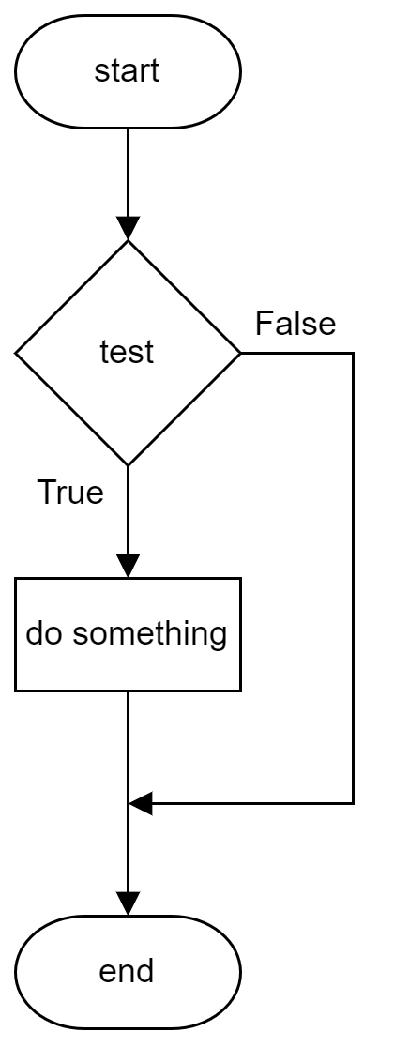
Flowchart – If
1 age = 0
2
3 age = int(input("Age? "))
4
5 if age >= 18:
6 print("Go in")
Notes:
Use draw.io to turn code into flowchart
Flowchart example just to show selection (if), not the program

Slide 296
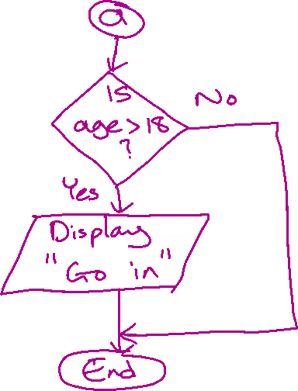
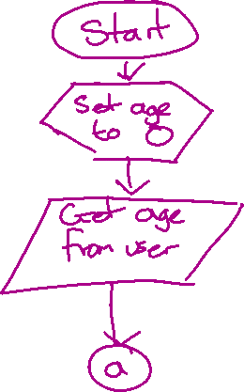

Slide 297
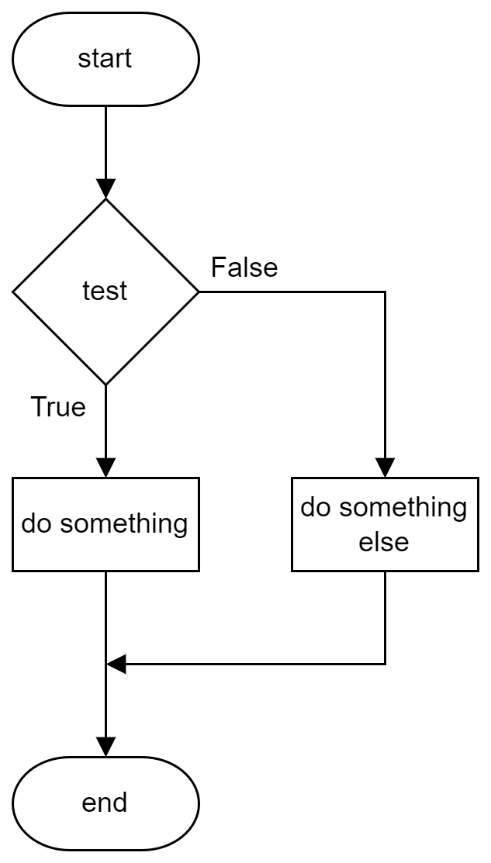
Flowchart – Else
1 age = 0
2
3 age = int(input("Age? "))
4
5 if age >= 18:
6 print("Go in")
7 else:
8 print("Get out!")
Notes:
Use draw.io to turn code into flowchart
Flowchart example just to show selection (if, else), not the program

Slide 298
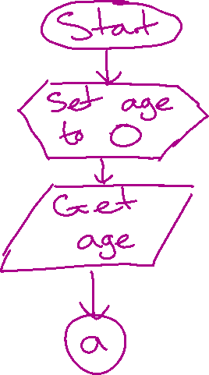
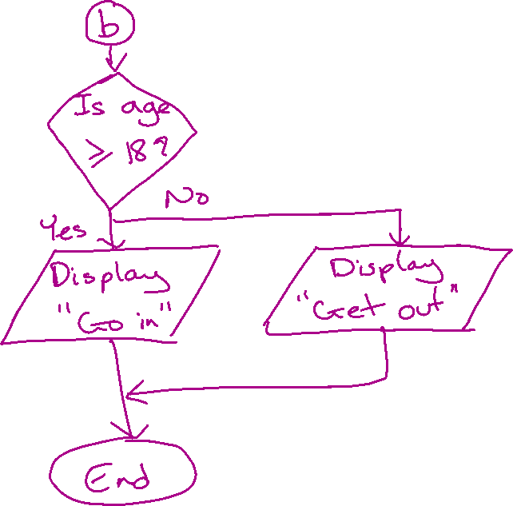

Slide 299
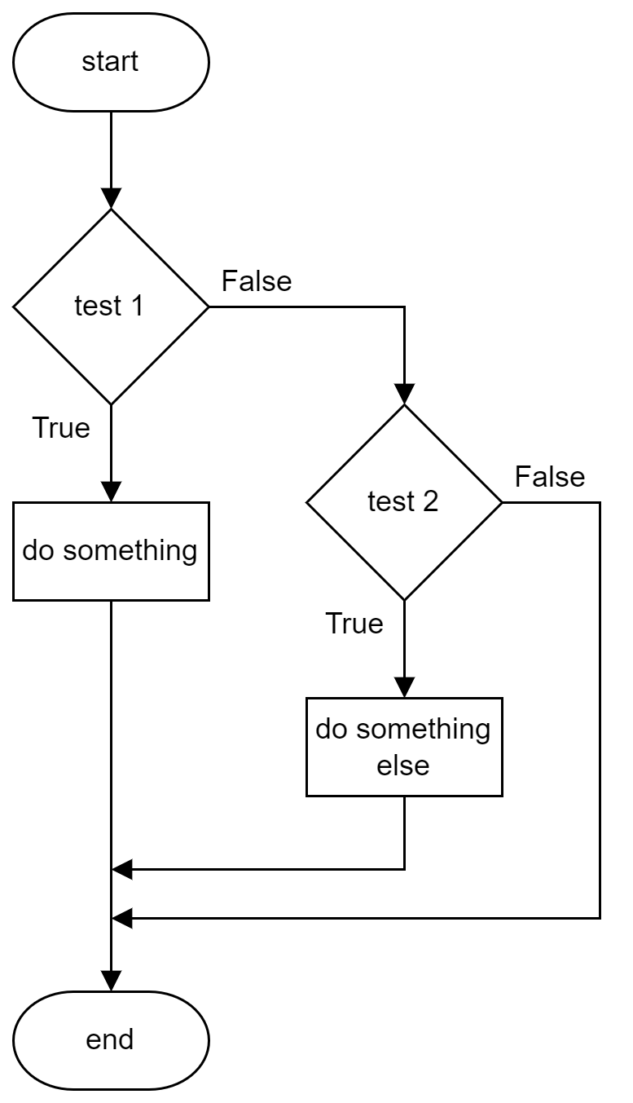
Flowchart – Else If
1 mark = 0
2 mark = int(input("Mark? "))
3 if mark >= 85:
4 print("Distinction")
5 elif mark >= 50:
6 print("Pass")
7 else:
8 print("Fail")
Notes:
Use draw.io to turn code into flowchart
Flowchart example just to show selection (if, else if), not the program

Slide 300
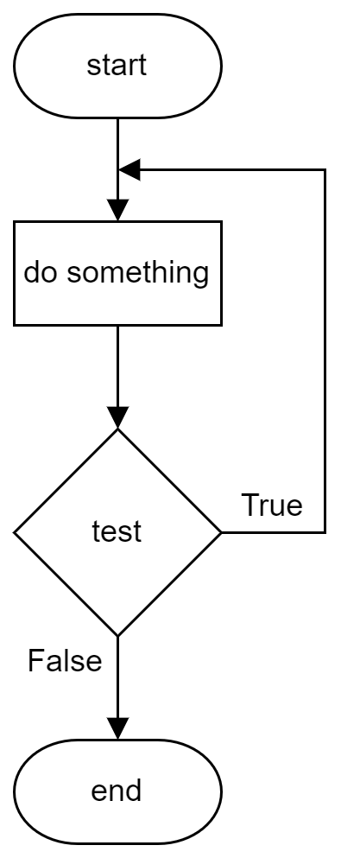
Flowchart – While (Repeat … Until)
1 cost, total, more = 0, 0, ""
2
3 while more != "n":
4 cost = int(input("Cost? "))
5 total = total + cost
6 more = input("More? (y/n)")
7
8 print("Total: " + str(total))
Notes:
Use draw.io to turn code into flowchart
Flowchart example just to show conditional loop, not the program

Slide 301
Learning Intentions
Describe, identify, and be able to read and understand:
structure diagrams
flowcharts
pseudocode
Exemplify and implement one of the above design techniques to design efficient solutions to a problem.
Notes:
S4 pupils, not S3

Slide 302
Pseudocode
Written in structured English
Main steps show algorithm
Refinements show detail
SQA Reference Language (SQARL) != Pseudocode

Slide 303
Pseudocode
Written in
Main steps
Refinements
SQA Reference Language (SQARL)

Slide 304
Pseudocode – Example
1 Ask user to enter rectangle dimensions
2 Calculate perimeter
3 Calculate area
4 Display results
1.1 Ask user for length
1.2 Ask user for breadth
3.1 Calculate area: length x breadth
Algorithm
Refinements
Not all refinements shown
Notes:
Calculate perimeter and area of a rectangle

Slide 305
Pseudocode – Example
1 Ask user to enter rectangle dimensions
2 Calculate perimeter
3 Calculate area
4 Display results
1.1 Ask user for length
1.2 Ask user for breadth
3.1 Calculate area: length x breadth

Slide 306
Learning Intentions
Describe, exemplify, and implement user-interface design, in terms of input and output, using a wireframe.
Notes:
S4 pupils, not S3

Slide 307
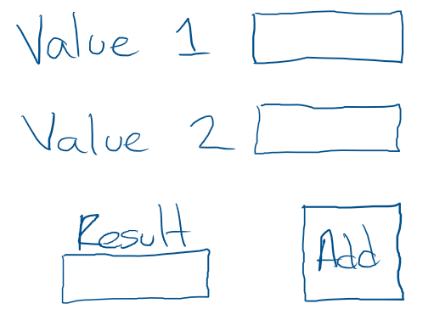
UI Wireframe
Used to show the inputs and outputs
Initially just a sketch
Inputs
Output
Submit
(to processes)
Notes:
Calculate perimeter and area of a rectangle

Slide 308
UI Wireframe
Used to show
Initially just
Notes:
Calculate perimeter and area of a rectangle

Slide 309
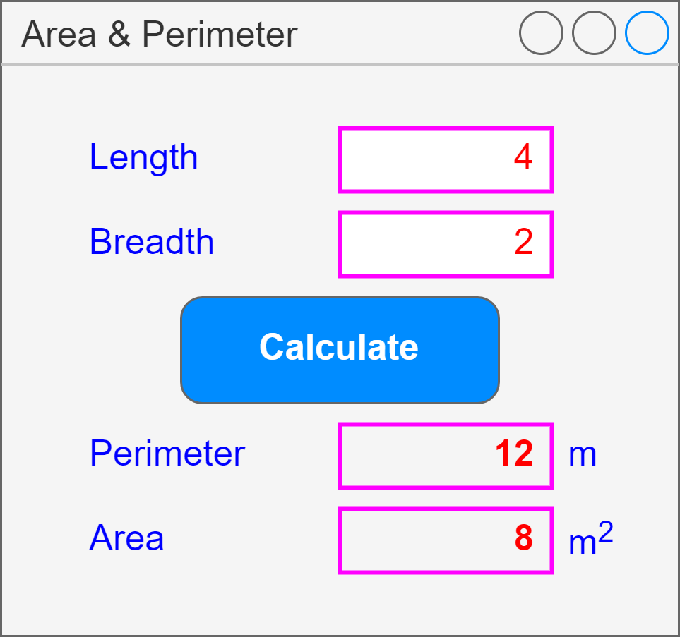
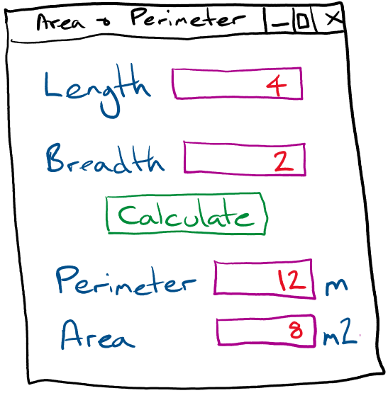
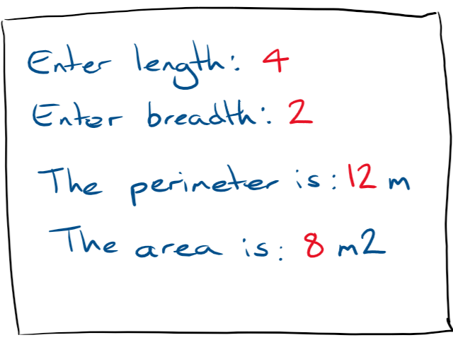
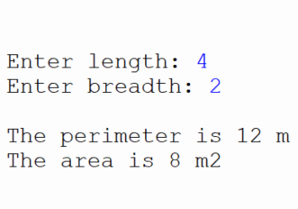
UI Wireframe – Example
App Based
Text Based
Text box
Inputs
Button
Submit
(process)
Outputs
Label
Notes:
Calculate perimeter and area of a rectangle
Use draw.io for app based version
Use Replit to implement text based version

Slide 310
UI Wireframe – Example
Notes:
Calculate perimeter and area of a rectangle
Use draw.io for app based version
Use Replit to implement text based version

Slide 311
Evaluation

Slide 312
Learning Intentions
Describe, identify, and exemplify the evaluation of a solution in terms of:
fitness for purpose
efficient use of coding constructs
robustness
readability:
internal commentary
meaningful identifiers
indentation
white space

Slide 313
Fitness for Purpose
Comparison of solution (code and testing) with program analysis, not design, and expected output
Does it do the requirements identified during analysis
Own code. Justify it!

Slide 314
Fitness for Purpose
Comparison of solution (code and testing) with program
Does it do the requirements

Slide 315
Efficiency
Describe efficiencies or inefficiencies
Array vs multiple variables
Nested ifs (else ifs) vs individual ifs
Use of a loop vs repetition of code
Own code. Justify it!

Slide 316
Efficiency
Describe efficiencies
Array
Nested ifs (else ifs)
Use of a loop

Slide 317
Robustness
Input validation (exceptional tests), or lack of it
Potential for errors – possible to enter incorrect values?
How it responds to unexpected data: text instead of number
Own code. Justify it!

Slide 318
Robustness
Input validation (exceptional tests)
Potential for errors
How it responds to unexpected data

Slide 319
Internal Commentary
Explains what the code does
Helps clarify complex code
Helps others / future self
Own code. Justify it!

Slide 320
Internal Commentary
Explains what
Helps clarify
Helps others

Slide 321
Meaningful Identifiers
Names relate to the data
Names indicate what they do / hold
Own code. Justify it!

Slide 322
Meaningful Identifiers
Names
Names indicate what

Slide 323
Indentation
Highlights structures
Own code. Justify it!

Slide 324
Indentation

Slide 325
White Space (Blank lines)
Between structures in program
Easier to see sections of code
Own code. Justify it!

Slide 326
White Space
Between
Easier to

